Slide 1
Exercise 1 – Toffoli gate
Gate decomposition BoSeong Kim
IBM Quantum Challenge 2021

Slide 2
Table of Contents
Qubit
Basic Gates
Composition of Gates
IBM Quantum Challenge 2021

Slide 3



Bit
What is a bit?
IBM Quantum Challenge 2021

Slide 4



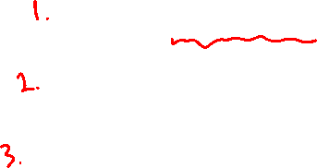
Qubit
What is a qubit?
IBM Quantum Challenge 2021

Slide 5

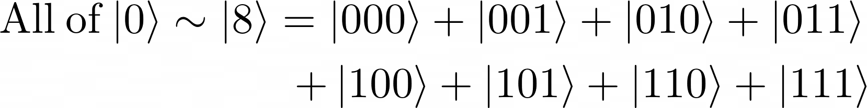


Qubit
For example…
IBM Quantum Challenge 2021

Slide 6

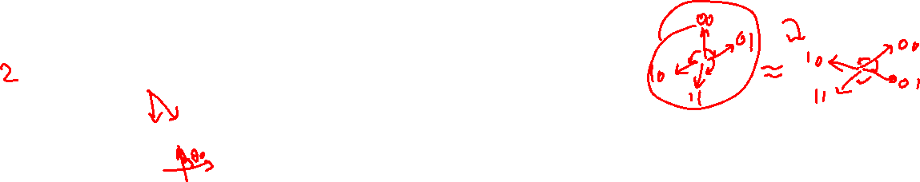
Qubit
Amplitude and phase
IBM Quantum Challenge 2021

Slide 7
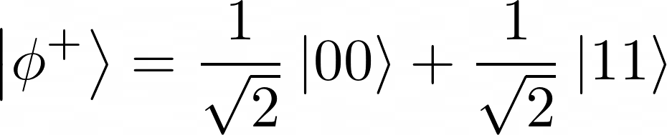
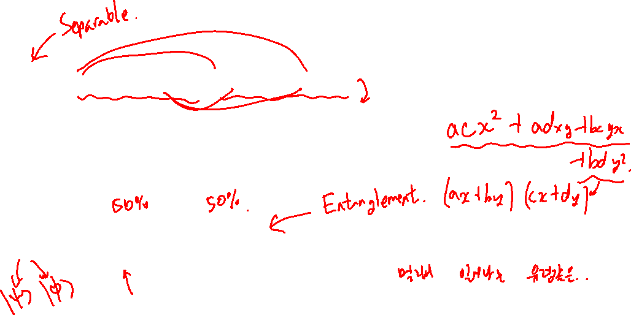
Qubit
Why not?
How about?

Slide 8
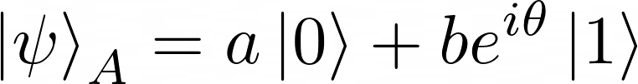

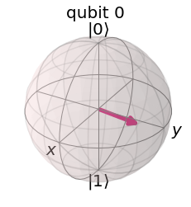
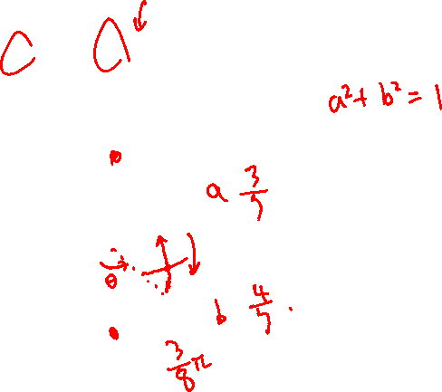
Qubit
Bloch sphere
Represents just a single qubit.
Not the whole information included.
But shows well how the gates work
IBM Quantum Challenge 2021

Slide 9
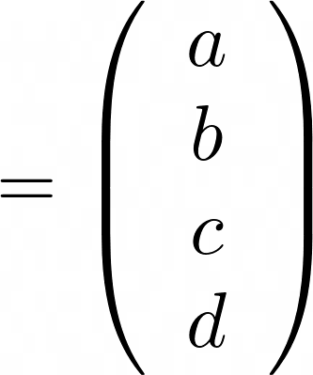
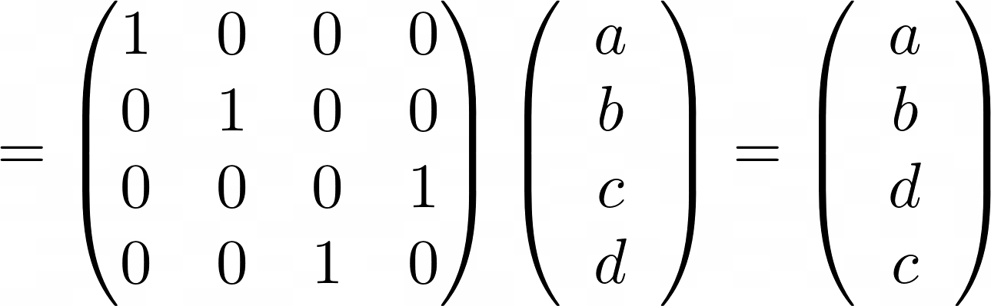
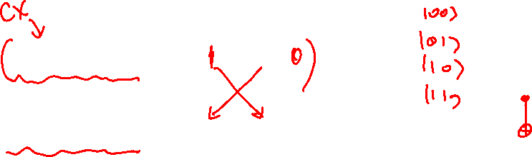
Matrix Representation
How we represent qubits and gates by matrix
IBM Quantum Challenge 2021

Slide 10

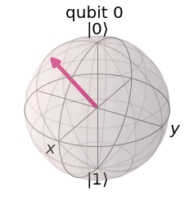
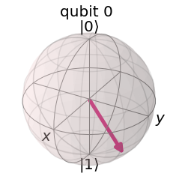

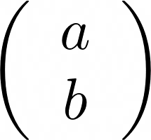
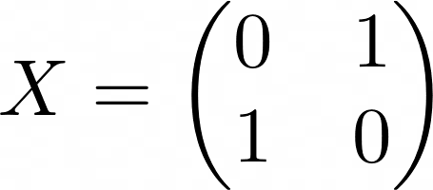
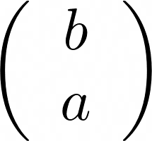
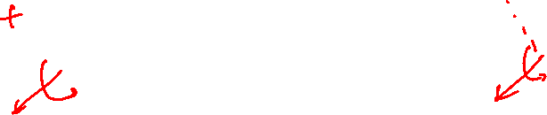
Basic Gates
X gate
IBM Quantum Challenge 2021

Slide 11
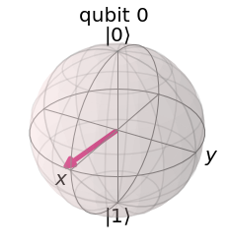

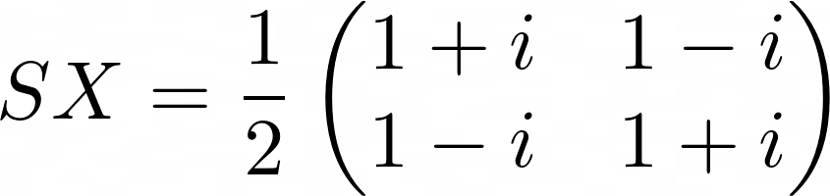
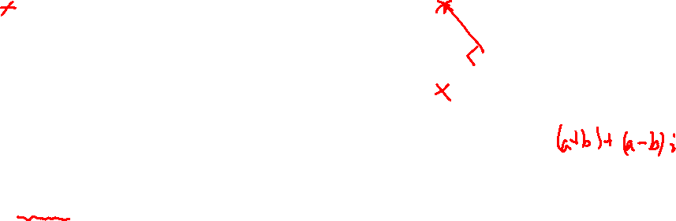
Basic Gates
SX = Square-root X gate
IBM Quantum Challenge 2021

Slide 12
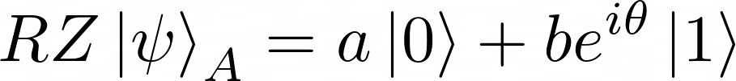
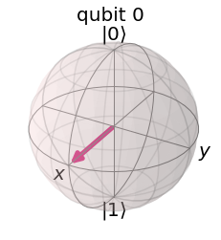
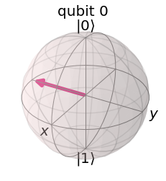

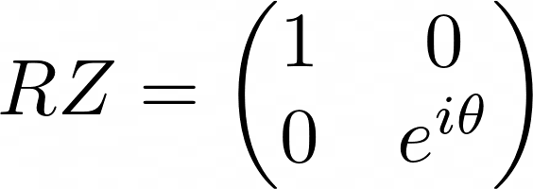
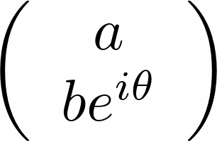
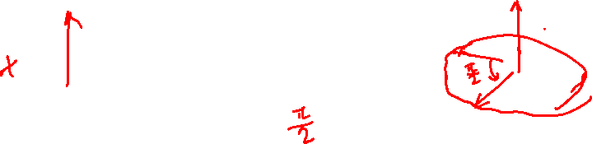
Basic Gates
RZ = Rotation around Z gate
IBM Quantum Challenge 2021

Slide 13
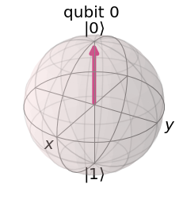
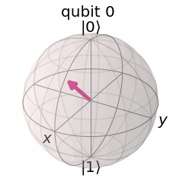


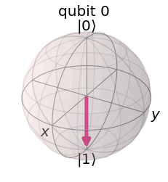
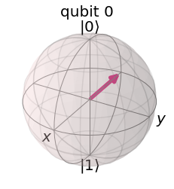
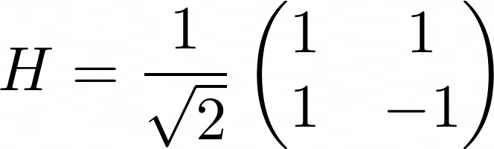
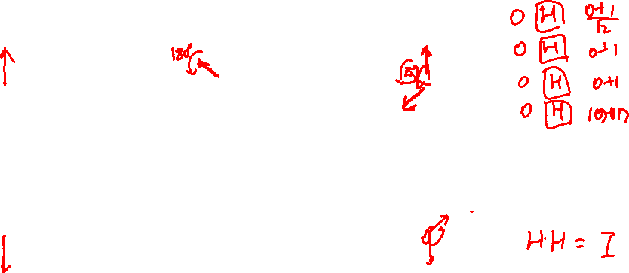
Basic Gates
H = Hadamard gate
IBM Quantum Challenge 2021

Slide 14
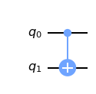

Basic Gates
CX = Controlled X = Controlled NOT = CNOT gate
IBM Quantum Challenge 2021

Slide 15
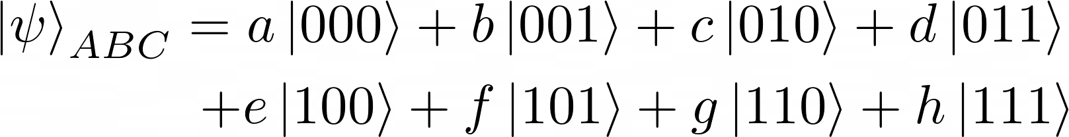
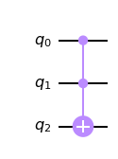
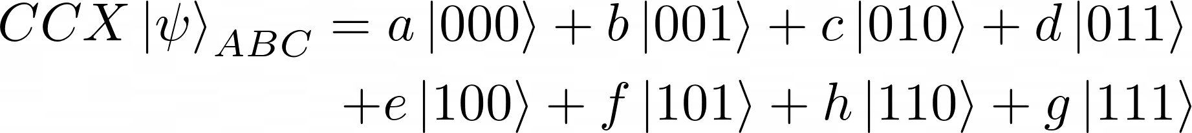
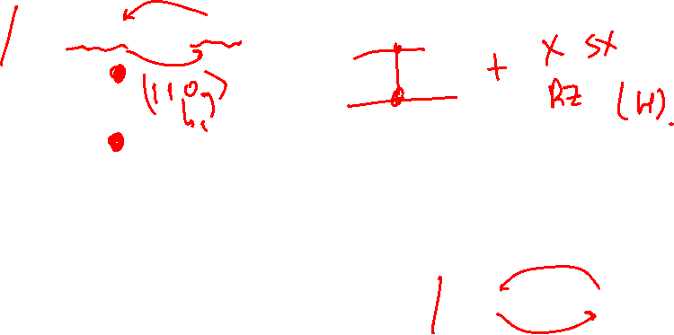
Basic Gates
CCX = Controlled controlled X = Toffoli gate
IBM Quantum Challenge 2021

Slide 16
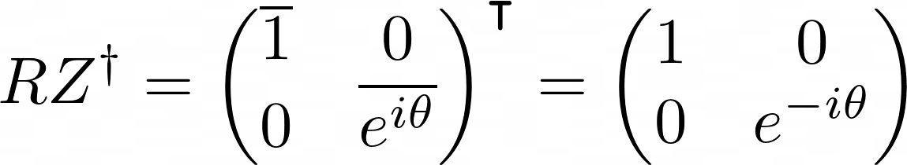
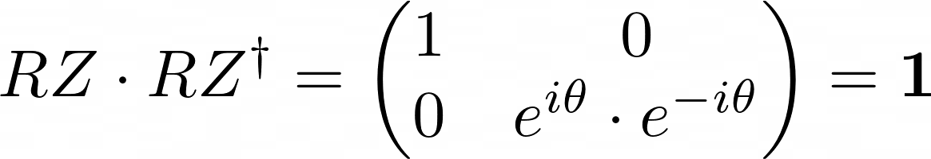

Single Qubit Gate
Single qubit gates are 2x2 unitary matrix
IBM Quantum Challenge 2021

Slide 17
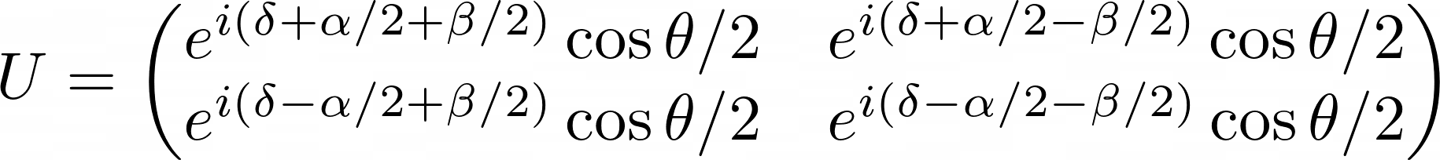
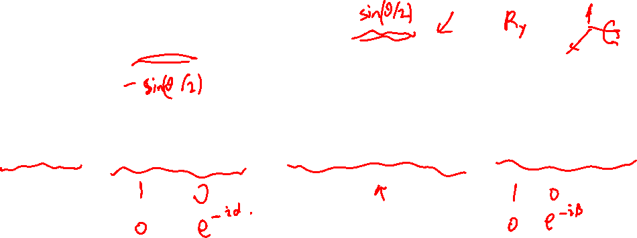
Decomposition of Unitary Matrix
Any unitary matrix can be decomposed to..
IBM Quantum Challenge 2021

Slide 18
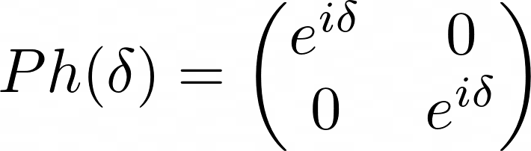
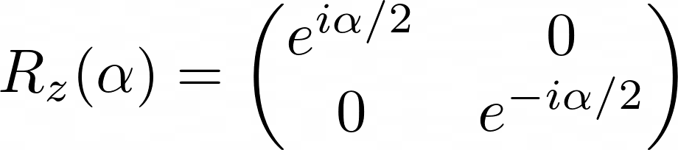
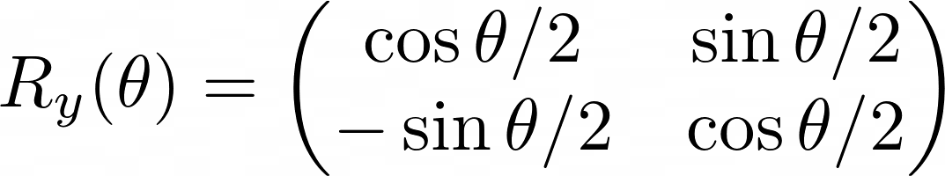
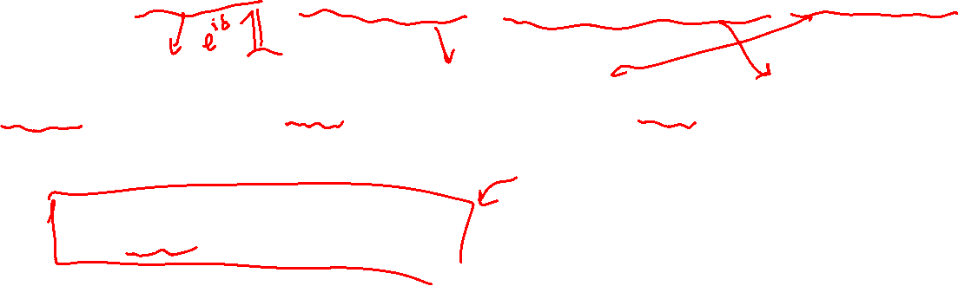
Operation Definition
Definition description
IBM Quantum Challenge 2021

Slide 19

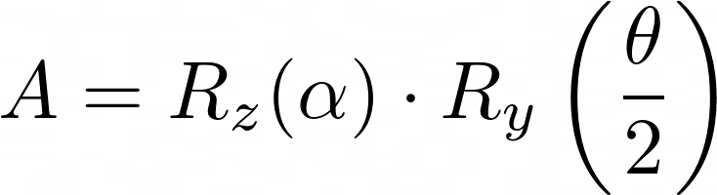
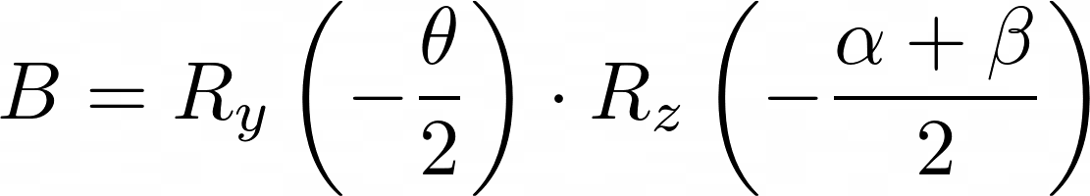
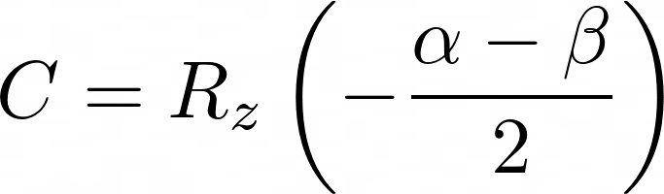
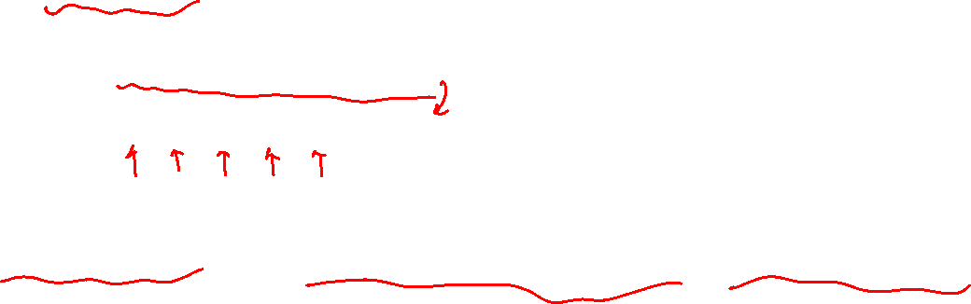
Special Unitary
For
IBM Quantum Challenge 2021

Slide 20

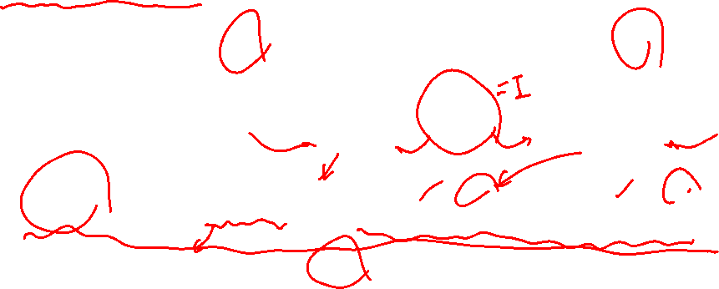
Special Unitary
Proof
IBM Quantum Challenge 2021

Slide 21



Special Unitary
For
with..
IBM Quantum Challenge 2021

Slide 22


Controlled Special Unitary Gate
Proposition
IBM Quantum Challenge 2021

Slide 23

Controlled Special Unitary Gate
Description
IBM Quantum Challenge 2021

Slide 24






Controlled Unitary Gate
Then…
IBM Quantum Challenge 2021

Slide 25



Controlled Unitary Gate
Therefore, any controlled unitary gate are equivalent to..
IBM Quantum Challenge 2021

Slide 26



Controlled-controlled Unitary Gate
Proposition
where
IBM Quantum Challenge 2021

Slide 27






Controlled-controlled Unitary Gate
Description
IBM Quantum Challenge 2021

Slide 28



Controlled-controlled Unitary Gate
Description
IBM Quantum Challenge 2021

Slide 29





Controlled-controlled Unitary Gate
Description
IBM Quantum Challenge 2021

Slide 30




Controlled-controlled Unitary Gate
Description
IBM Quantum Challenge 2021

Slide 31
Using Quantum Composer
Using Quantum Composer
Running on real backend
Transpiled circuit (!)
IBM Quantum Challenge 2021

Slide 32
Reference
IBM Quantum Challenge 2021. Exercise 1 – Toffoli gate. https://challenges.quantum-computing.ibm.com/iqc21
Barenco, et al. Elementary gates for quantum computation. https://arxiv.org/abs/quant-ph/9503016
IBM Quantum Challenge 2021

Slide 33
Thank you
BoSeong Kim
IBM Quantum Challenge 2021

